Slide 1
10 GHz Basics
How to do it and how not to do it.
By N0EDV

Slide 2
What exactly are microwaves?
Most of you are familiar with the term “wavelength”…
Wavelength (in Meters) = 300/frequency (in MHz).
Examples:
For 28 MHz, the wavelength is 10.7 Meters (hence we call it 10M)
For 144 MHz, the wavelength is 2.1 Meters, or as we say, the 2M band.
Now let’s see about our 10 GHz band. 10 GHz is 10,000 MHz. Therefore:
The wavelength is 0.03M. Since we generally dislike using decimals to describe wavelength, we convert to centimeters, giving us the 3cm band!

Slide 3
Let’s do a little comparison…
When building antennas, we use a simplified formula to figure out how long to cut an element to ¼ of a wavelength (in Ft.) using the formula:
234/frequency (in MHz)
So, at 28 MHz, it’s 8.36 Ft.
At 144 MHz, it’s 1.63 Ft. (19.5 Inches)
And at 10 GHz (10,000 MHz), it’s 0.0234 Ft. or 0.281 Inches!

Slide 4
BLOCK DIAGRAM of a typical Transverter System

Slide 5
What’s a “Transverter”?
In simple terms, it is simply a device that converts one set of frequencies to another set of frequencies! For example, if you have a 2M radio and you want to get on the 10 GHz band, during transmit, you convert the 144 MHz signal to 10,368 MHz and send it out to the antenna. During receive, the signals coming in to the antenna at 10,368 MHz are converted to 144 MHz so your 2M radio can detect them. It really IS that simple!

Slide 7
How it Works (in a nutshell)
1. Connect all the pieces together properly. Don’t forget to connect everything!
2. Power it up.
3. Coordinate with far end via cellphone (voice, text).
4. Figure out antenna azimuths for each end and relay that info to far end station.
5. One end sends 1 minute of CW dits or dahs so far end can zero in their antenna to peak RX. Far end now sends 1 minute of CW dits or dahs so you can peak your antenna. Make the QSO (CW/SSB/FM) and log it!

Slide 8
Things to make it go smooth
Find portable locations that have unobstructed views to the horizon in the desired direction (azimuth). It does not have to be a perfect line of sight between stations. The goal is to have at least one mile between your antenna and the first “obstruction”. When operating from the side of the road, soybean field is good, corn is not. Your signal will be above the soybeans, but hard to clear corn that is 6 to 8 feet tall.

Slide 9
What a marginal site looks like…

Slide 10
What a great site looks like…

Slide 11
More things to make it easier…
Use an L.O. that is accurate and stable. Most folks today use PLL oscillators that may be locked to GPS satellites for excellent accuracy and stability.

Slide 12
Using GPS locked L.O.s eliminates the uncertainty of the L. O. frequency. In the old days, before PLL usage, you had to guess your frequency and try to compensate for frequency difference AND antenna azimuth at the same time to hopefully find the other guy. MUCH easier if you BOTH know what frequency you are on as this means the only variable is antenna aiming. Success rates vastly improve!
Use the best components you can find/afford. RG-58 coax is useless at 10 GHz. Loss is astronomical! UT-141 hardline is vastly better. HOWEVER, even so, keep lengths as short as possible. I try to keep my runs between components less than 6 inches.
Antennas can be simple horns (less directive and less gain). Most higher performance stations use converted dishes from the satellite TV systems such as DirecTV or Dish Networks. A small horn can have a gain of 10 to 15 dB or so. An 18 inch DirecTV dish has about 33 dB of gain.

Slide 13
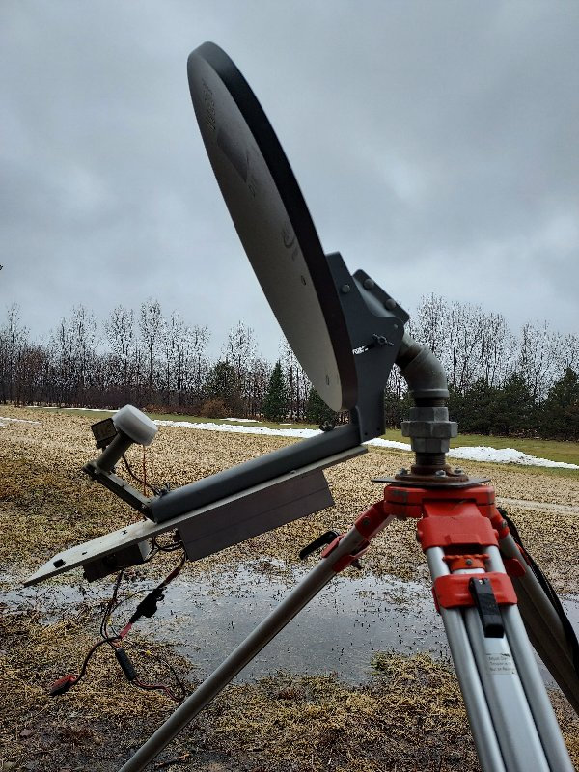

Slide 14
So…with 3W at 10 GHz into a dish antenna, the ERP is in the neighborhood of 5-6 THOUSAND Watts! It is not uncommon to communicate between a pair of 3W stations out to 400 Km (250 miles) even in mediocre conditions! With enhancements (such as rain scatter), 800 Km is not unheard of. Speaking of rain scatter, the following slide shows the expected range for stations using a rain cell as the scattering point. As you can see, some pretty decent range is possible!

Slide 16
In fact, we have a few over-achievers out there like W8BYA in Fort Wayne, Indiana. 50 Grids worked from his home station!

Slide 17
My station
I. F. Radio is Yaesu FT-817 modified for maximum output of 20mW.
Transverter is built from a basic Downeast Microwave 10 GHz transverter kit (10mW output).
Transverter drives a Downeast Microwave 3W amplifier.
T/R relay is an SMA RF relay. Common goes to antenna, N.C. contact goes to transverter RX input, N. O. contact goes to amplifier output.

Slide 21
Here’s a typical CW rainscatter contact…
My first 10ghz rainscatter contact! - YouTube

Slide 22
QUESTIONS?
NONE?
Good!
Just kidding, ask away!

